Slide 1

IDS PROJECT ON LAPTOP DETAILS
Project team members
Name
Saiprakash L Shetty
Dhanik Shetty
Sumanth Prasad

Slide 2
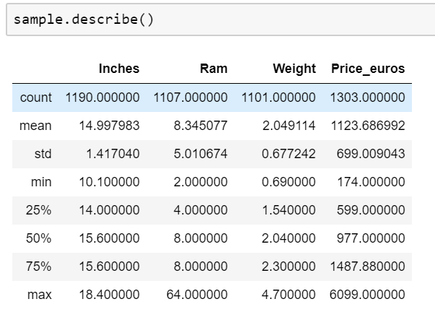
DETAILS OF THE DATASET
Total number of columns:12
Total number of rows:1304
Categorical column:8
Numerical column:4
Data as missing values and NaN: 3.69% (578)

Slide 3
2. Data Cleaning
In categorical columns, all the NaN values are replaced by previous row values.
In numerical columns, all the NaN values are replaced by the mean of that column
#data cleaning for numerical column
sample['Ram']=sample['Ram'].fillna(sample['Ram'].mean())
sample['Ram']
#categoirical cleaning
sample['Company']=sample['Company'].fillna(method='ffill')
sample['Company']

Slide 4
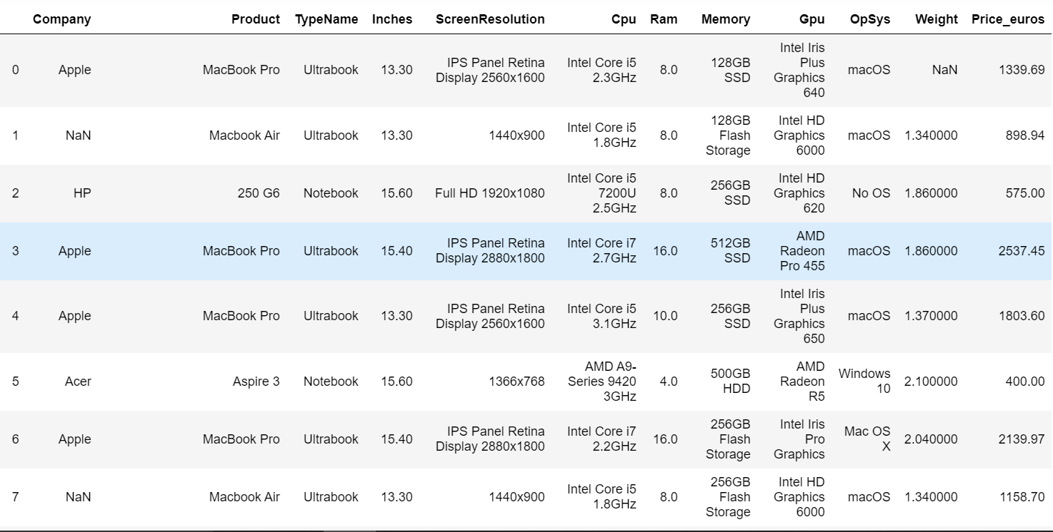
Before data cleaning

Slide 5
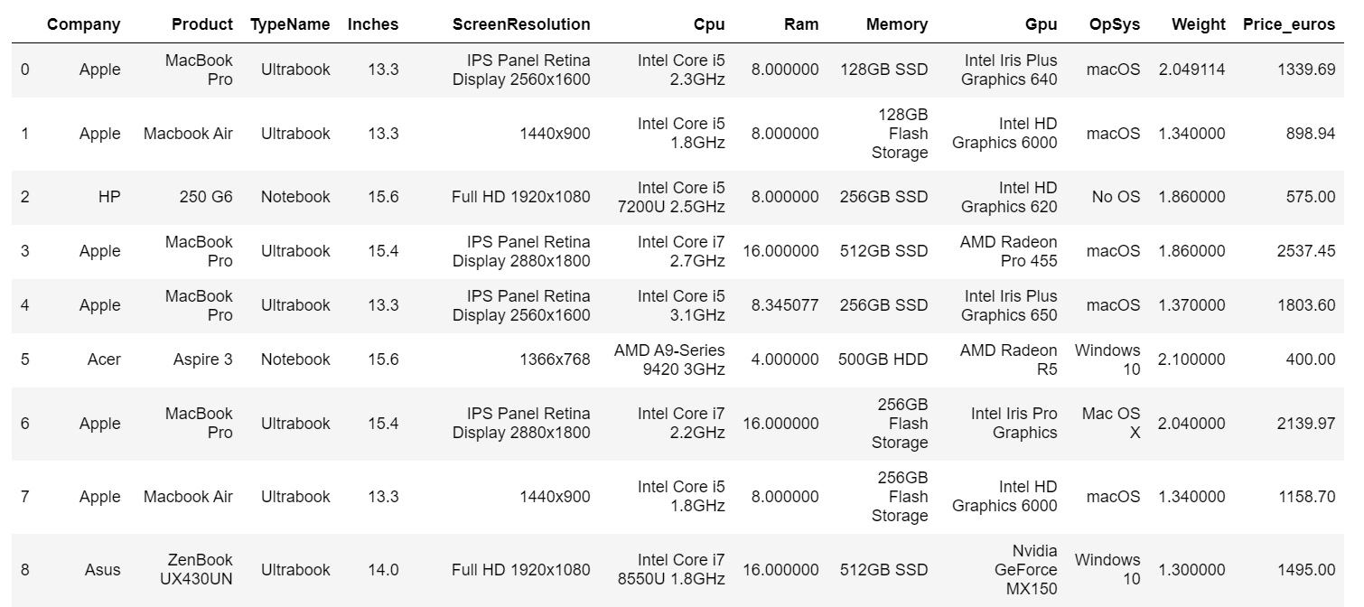
After data cleaning

Slide 6
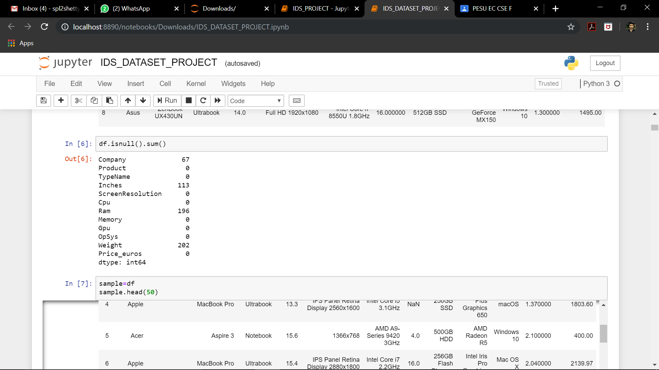
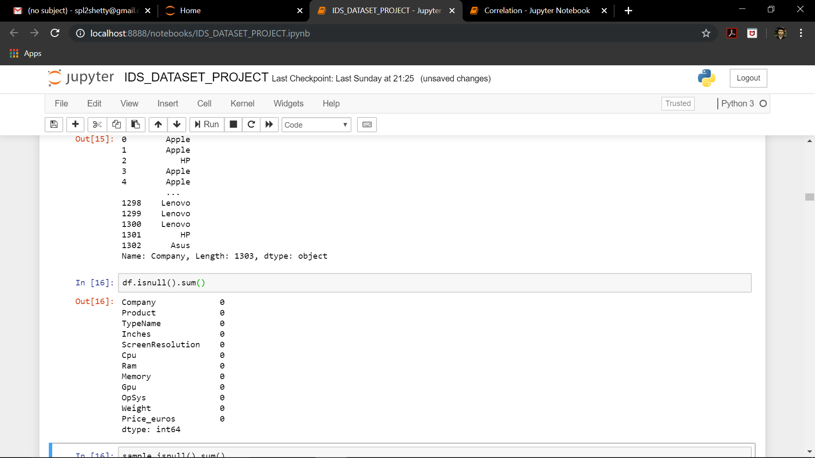
BEFORE DATA CLEANING
AFTER DATA CLEANING

Slide 7
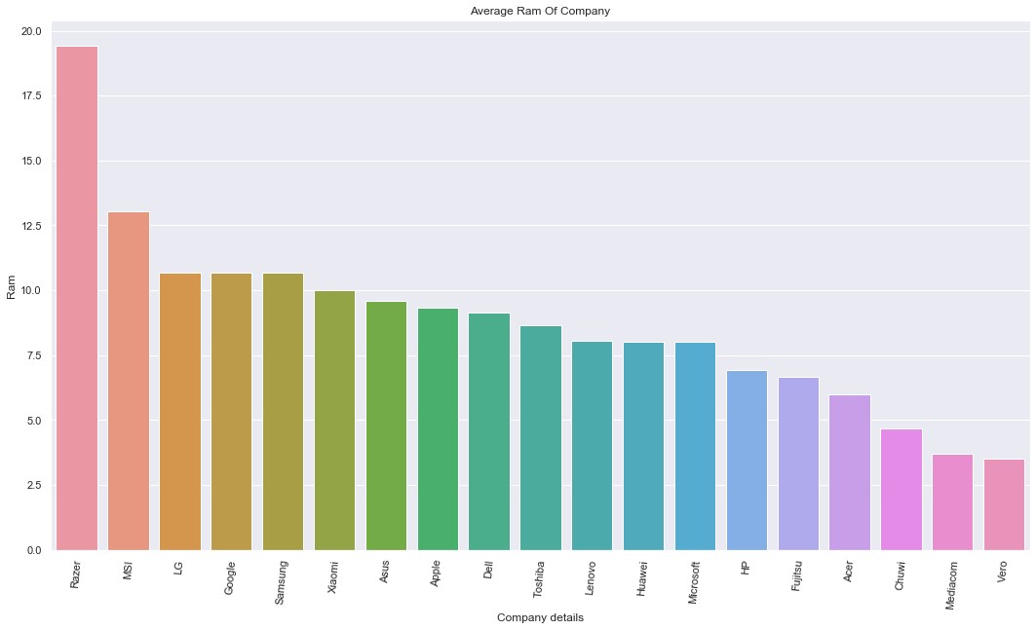
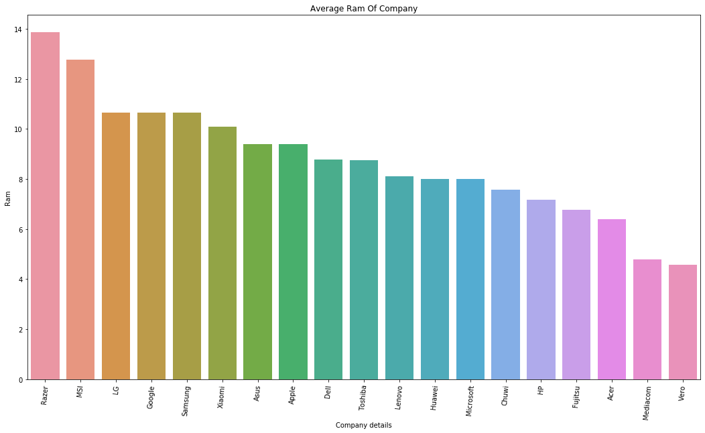
Company and the RAM used
Before cleaning
After cleaning

Slide 8
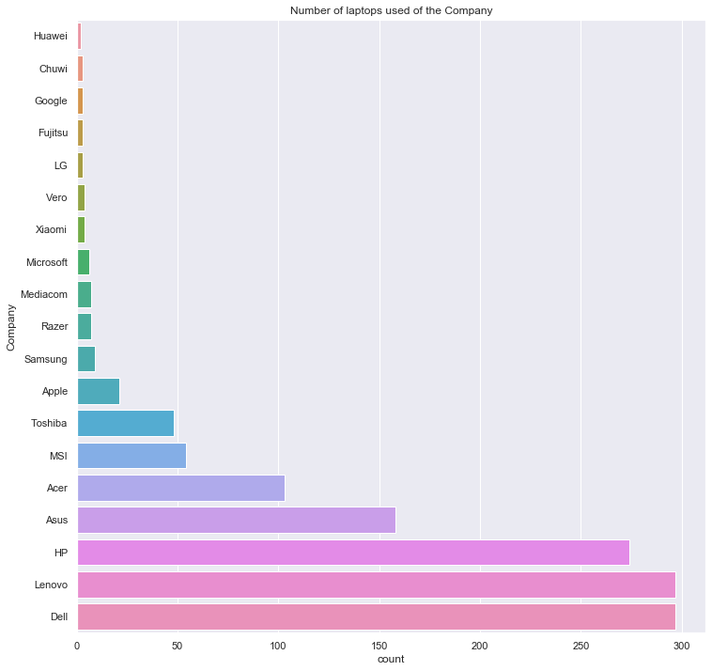

Number of laptops of a company
Before cleaning
After cleaning

Slide 9
3. Normalization
Normalization usually means to scale a variable to have a values between 0 and 1
Is Should we normalize data?
Normalizing data eliminates the units of measurement for data, enabling us to more easily compare data from different places.
Normalization helps in reducing complexity of the data.
It could eliminate outliers(if any)
Normalizing will ensure that a convergence problem does not have a massive variance, making optimization feasible.

Slide 10
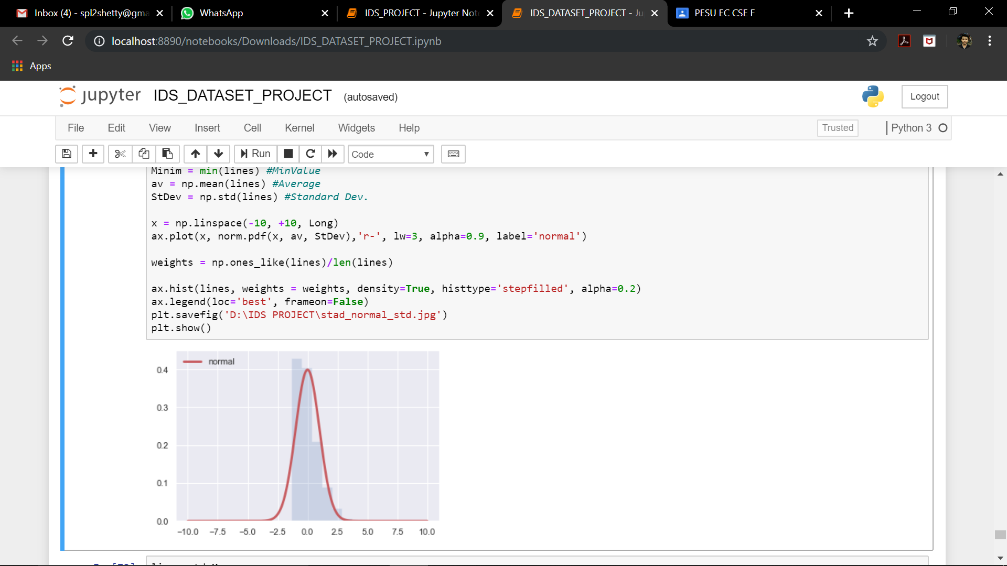
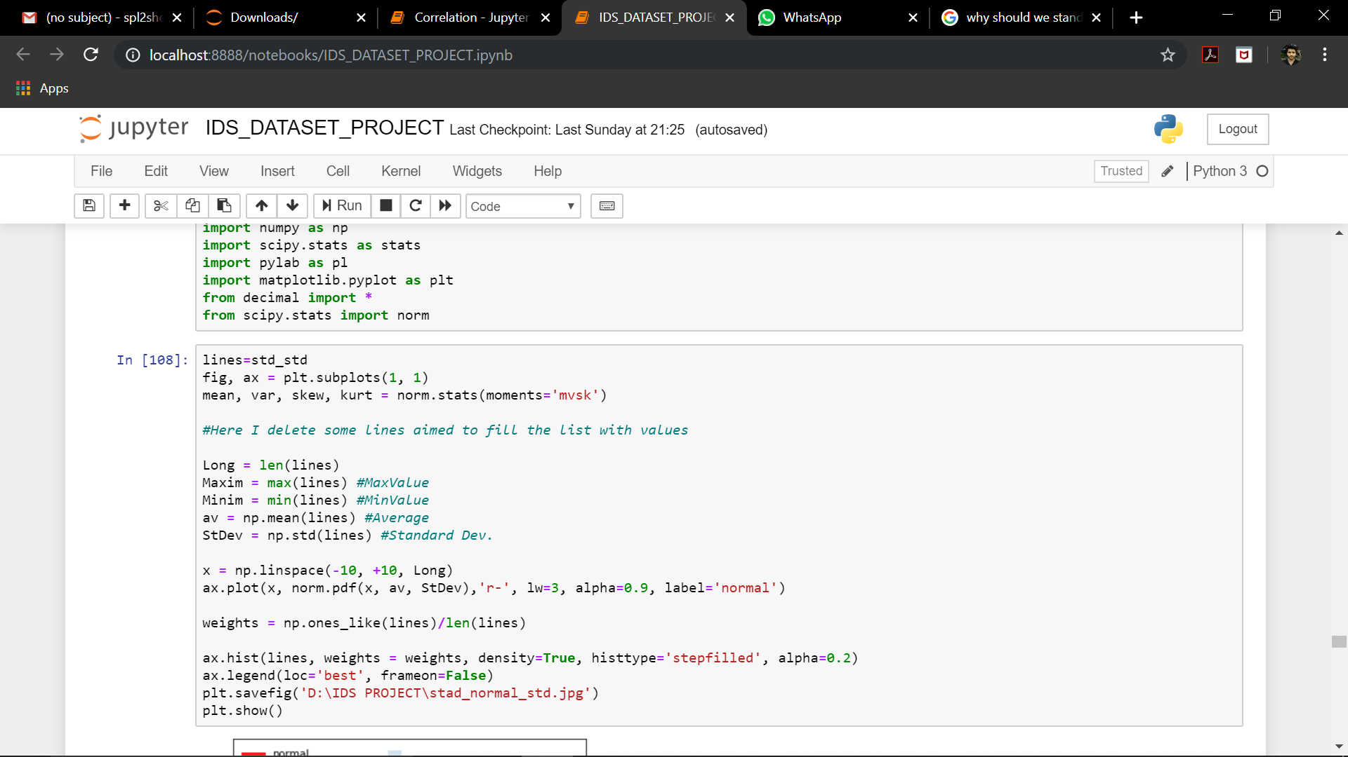
AFTER NORMALIZATION
Standardised mean

Slide 11
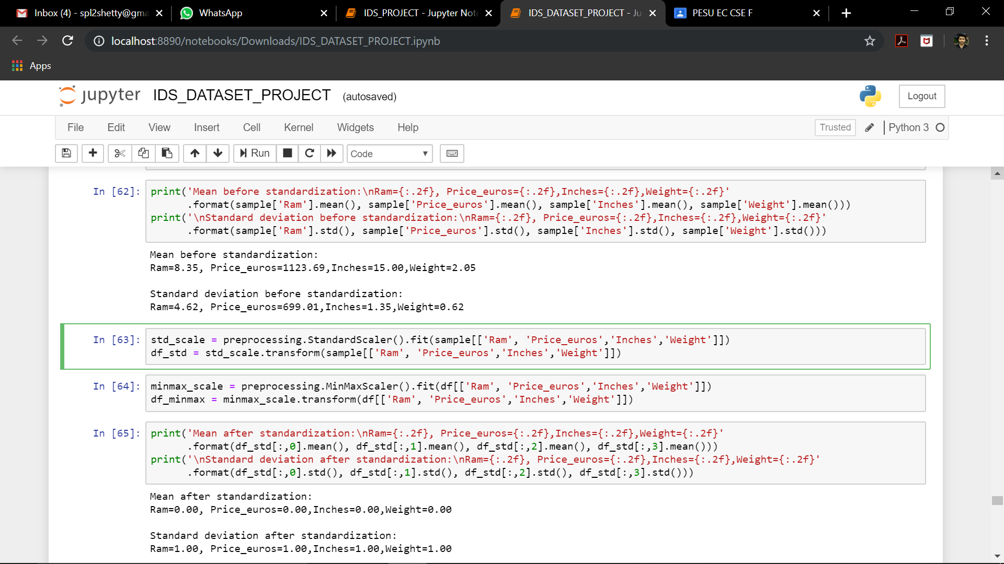
Standardization:
Standardization transforms data to have a mean of zero and a standard deviation of 1.
Before standardization:

Slide 12
After standardization:

Slide 13
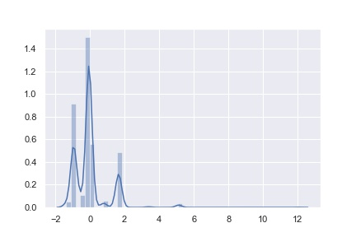
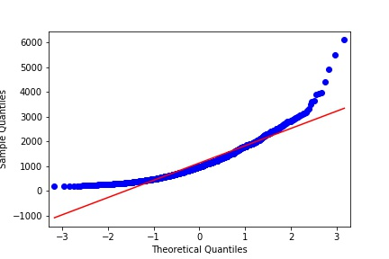
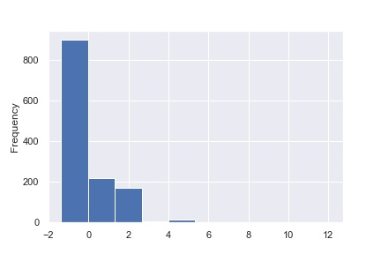
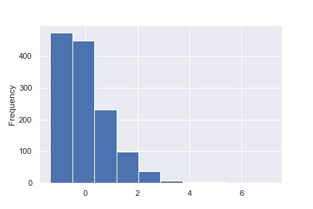
⬅QQ plot of Price_euros
After standardization
Distribution plot of standard→
Mean after standardization
⬅Histogram of standard mean
After standardization
Distribution plot of standard →
Mean after standardization

Slide 14
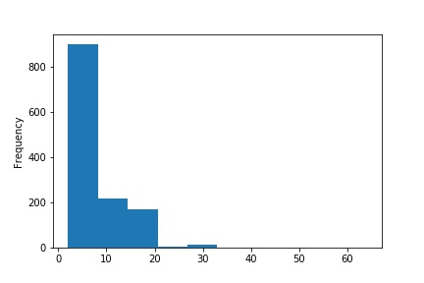
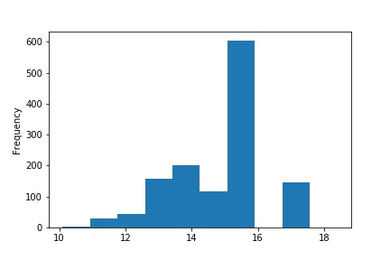
4. Graph visualization:
Histogram Plots
1.Ram of the laptops
2.Screen size in Inches of the laptops
Right skewed
Mode < median <mean.
Left skewed
Mode > median >mean.

Slide 15
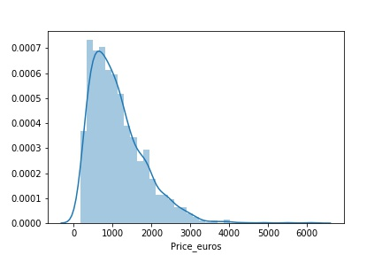
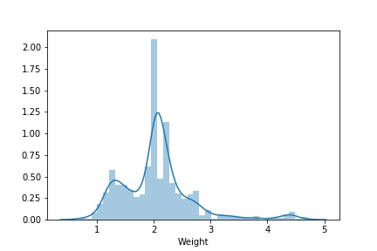
Distribution Plots
It tells us how normalised the graph is.
The Price_euros distribution is much more normalised than that of Weight distribution plot.

Slide 16
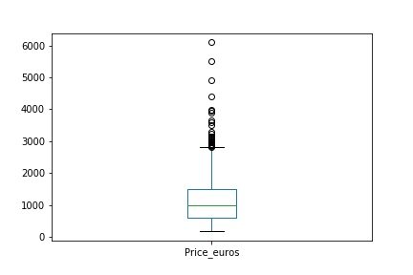
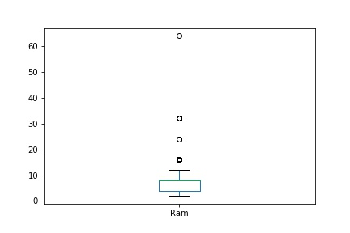
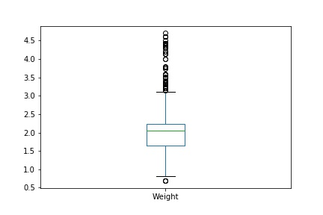
Box Plots
Box plot tells about the outliers present in the data
Weight column (in our data) contains a few number number of outliers
Price_euros box plot
Ram box plot
Weight box plot

Slide 17
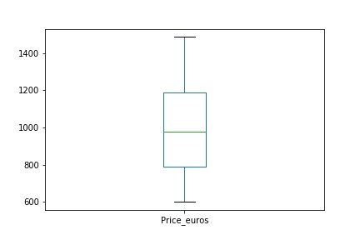
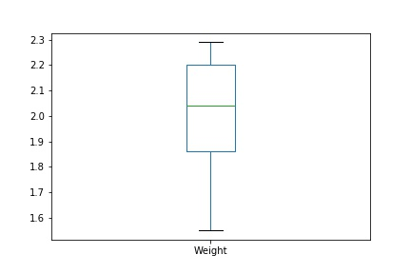
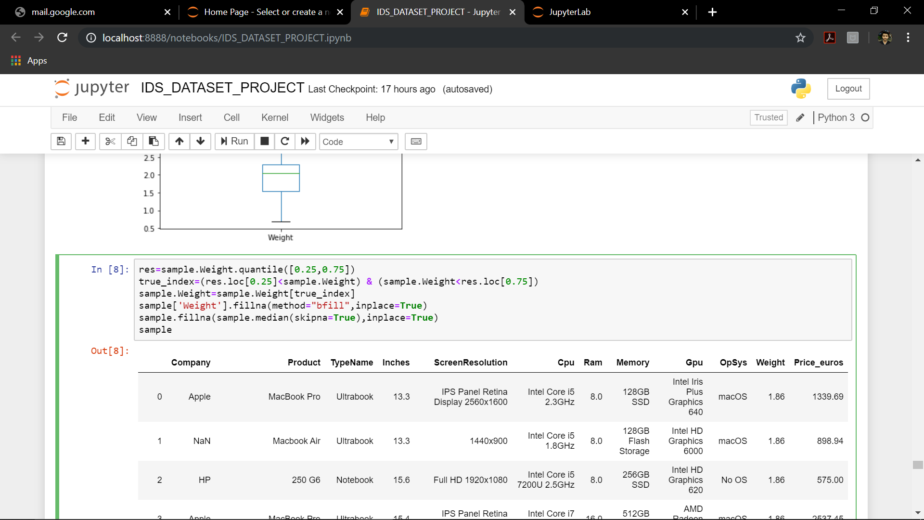
Box Plots After Removing Outliers
Price_euros box plot
Weight box plot

Slide 18
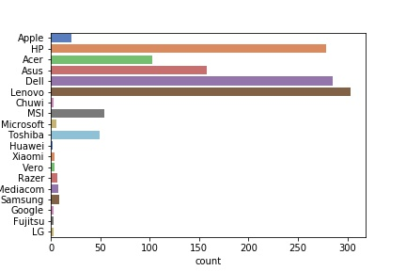
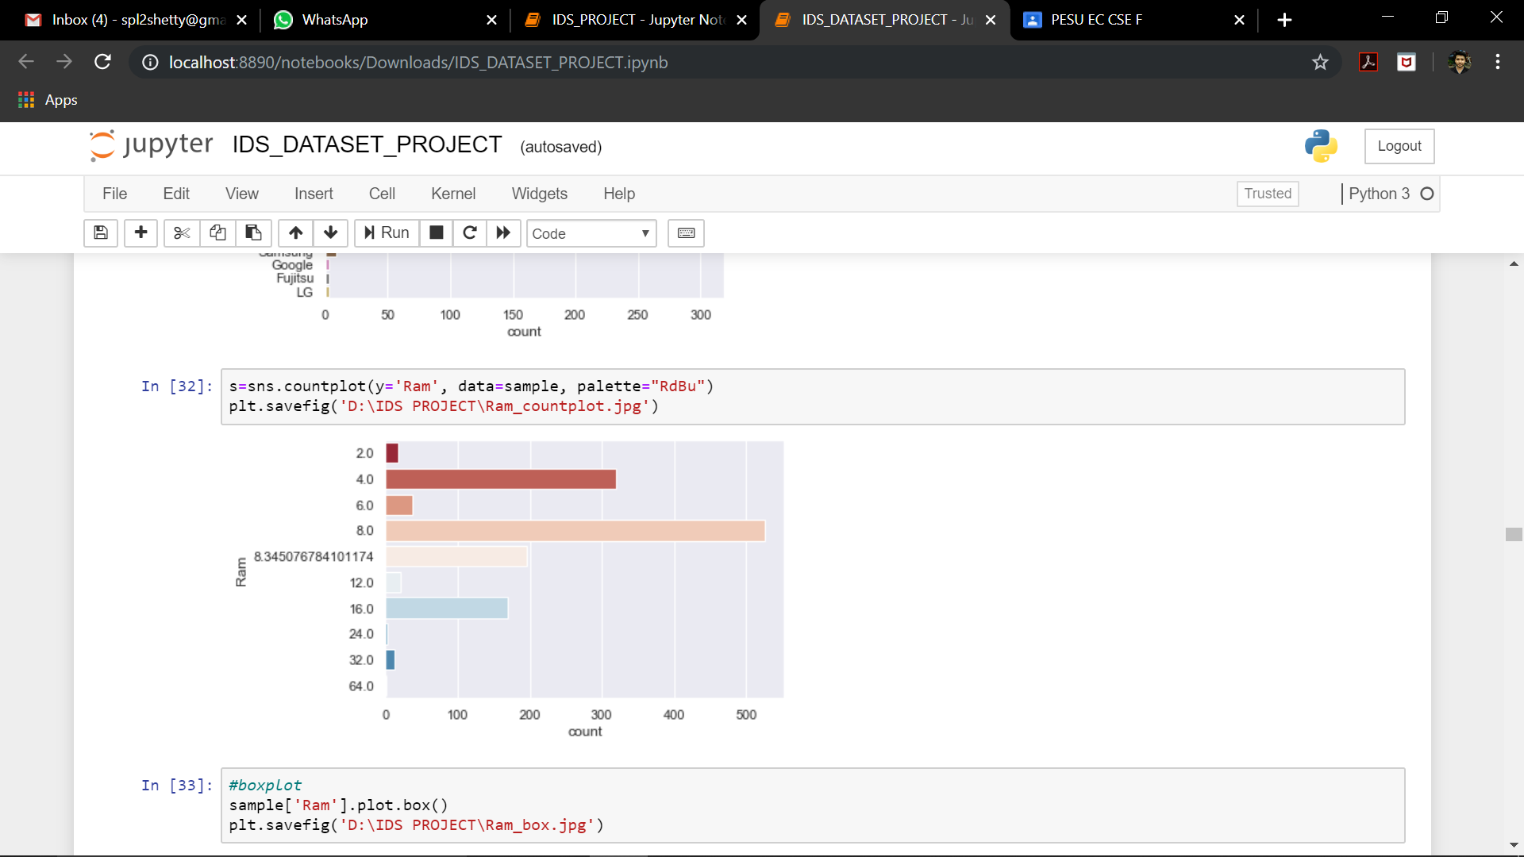
Counter Plot
→Lenevo,Dell,HP are the most widely used laptops
→Laptops with 8 GB RAM are most actively used in laptops

Slide 19
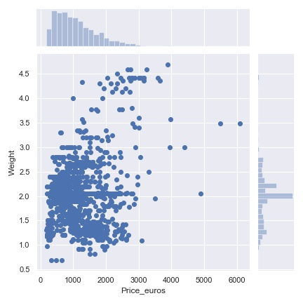
Scatter Plots
Like distribution plots they also tell how
normalized our data is ,unlike distribution
scatter plots is for plot between two
parameters(here Weight and Price_euros)

Slide 20
5. Hypothesis Testing:
Hypothesis testing is a statistical procedure that uses sample data to determine,
whether a statement about the value of a population parameter should rejected or not.
Hypothesis testing is done for Ram column.
population mean is 8.345 so we assume that the sample mean is same as population mean
Null hypothesis =Ho: µ=8.345
Alternate hypothesis=Ha: µ!=8.345

Slide 21
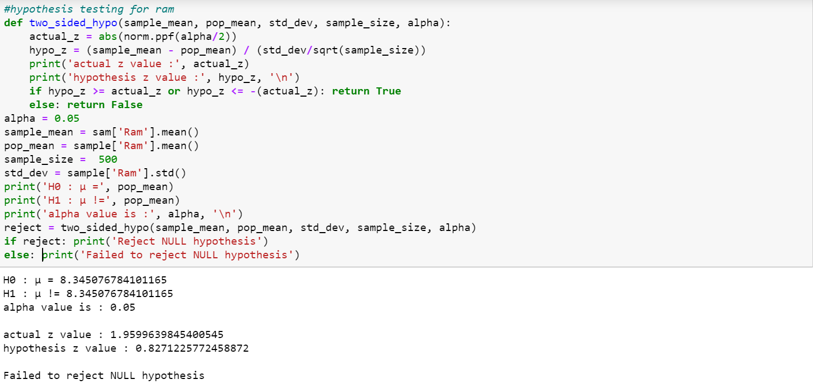
Two sided hypothesis testing on Ram:

Slide 22
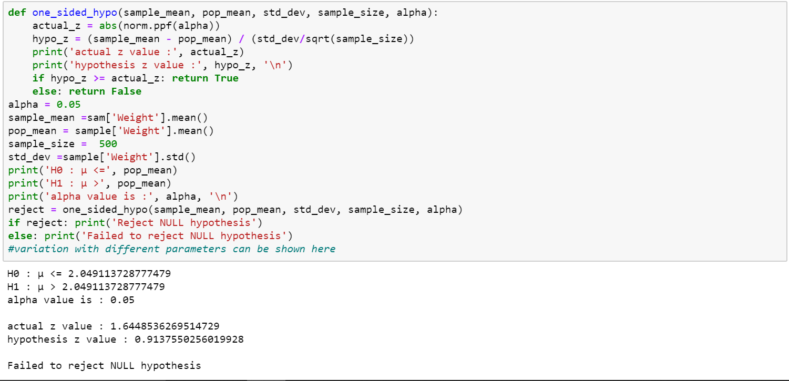
Here hypothesis testing is done for ‘Weight’ column.
Null hypothesis =Ho: µ <=2.049
Alternate hypothesis=Ha: µ >2.049

Slide 23
6. Correlation:
It measures the strength and direction of a linear relationship between two variables
r value always lies b/w -1 to 1
A correlation of:
1 indicates a perfect positive correlation.
-1 indicates a perfect negative correlation.
0 indicates there is no relationship between the different variables.
Values between -1 and 1 denote the strength of the correlation.

Slide 24
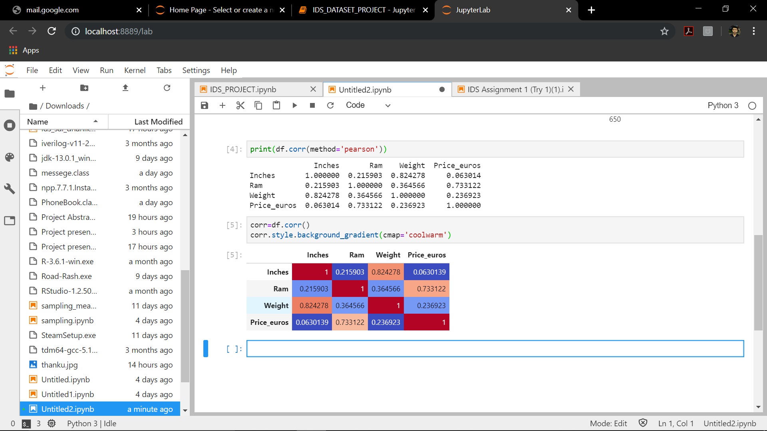

Slide 25
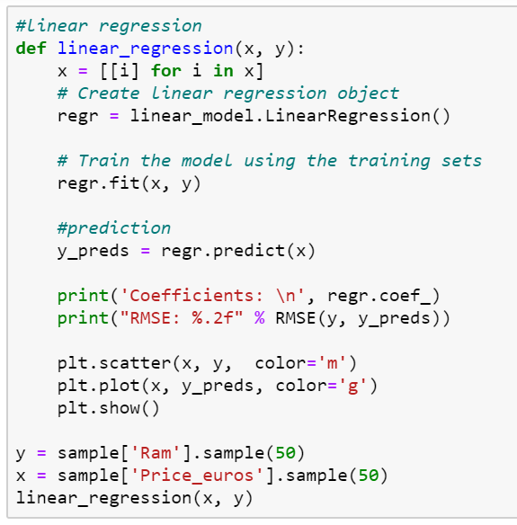
Correlation between Ram and
Price_euros .

Slide 26
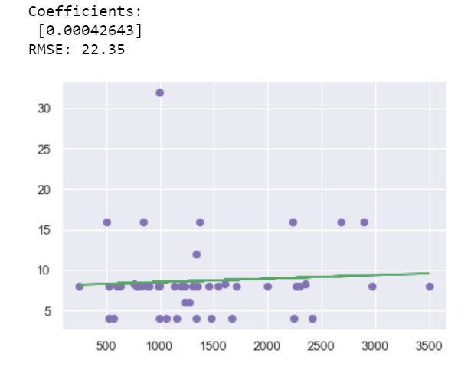
We conclude by the plot that as Ram increase,the price of the laptop also increases

Slide 27
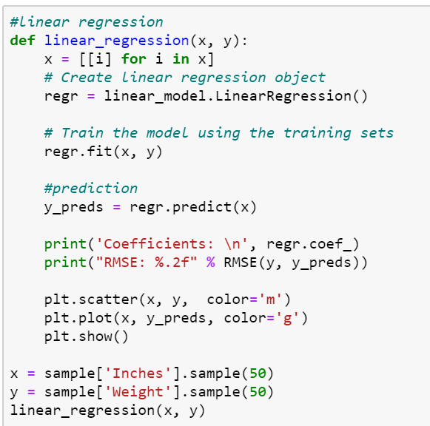
Correlation between Inches
(Screen size)Weight of the laptop.

Slide 28
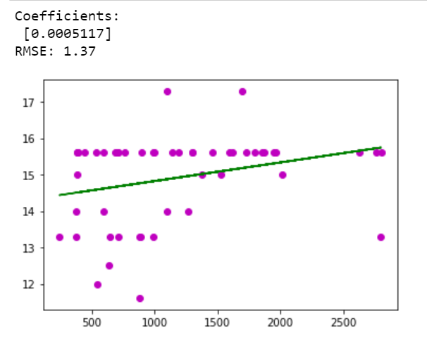
We can say the number of laptops with screensize-Inches
Within 15-16 and weight 1 -2.5 kg are the ones which are
heavily used

Slide 29
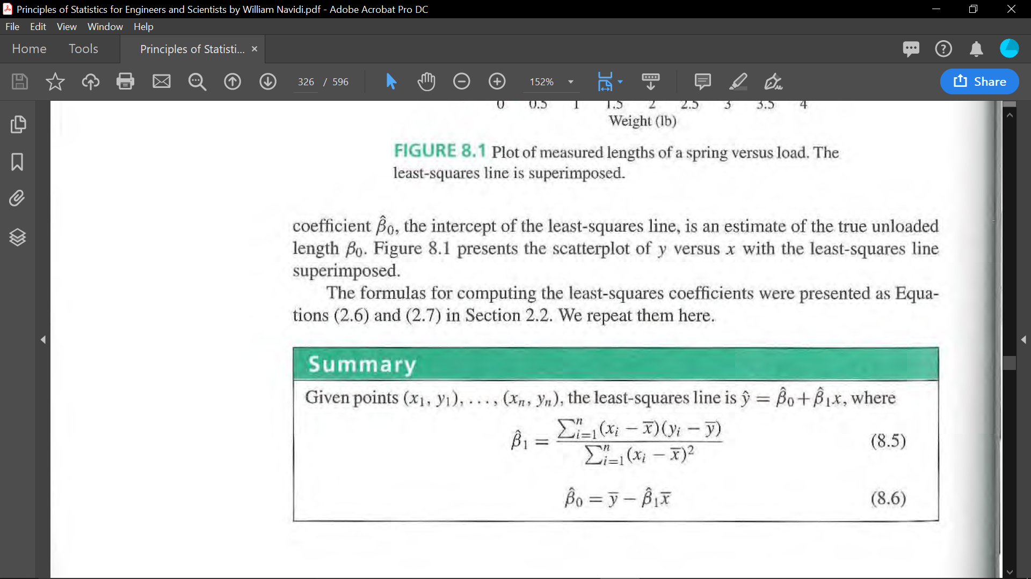
Line Equation for dependency of Weight (x) and Inches(y)
3.3094
8.9354
y = x +

Slide 30


